Slide 1
One enters the NeuroMaps Mapper through BrainInfo (http://braininfo.org)

Slide 2
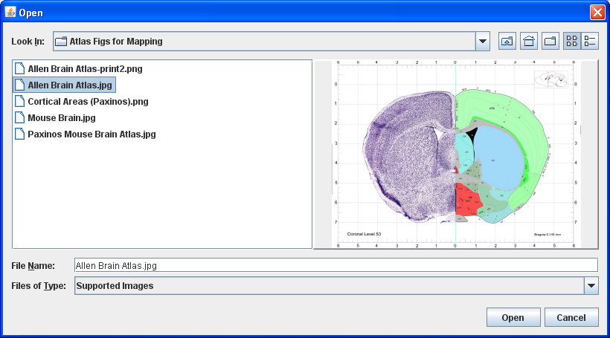
Load the image with the data you want to map into the Mapper… in this case a page from the Allen Reference Atlas

Slide 3
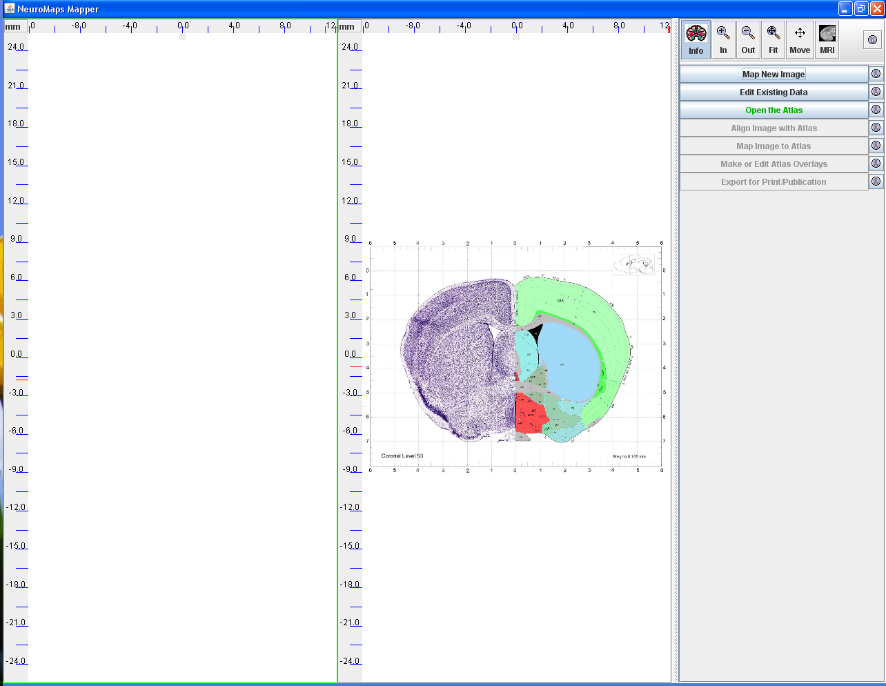
Open the Atlas

Slide 4
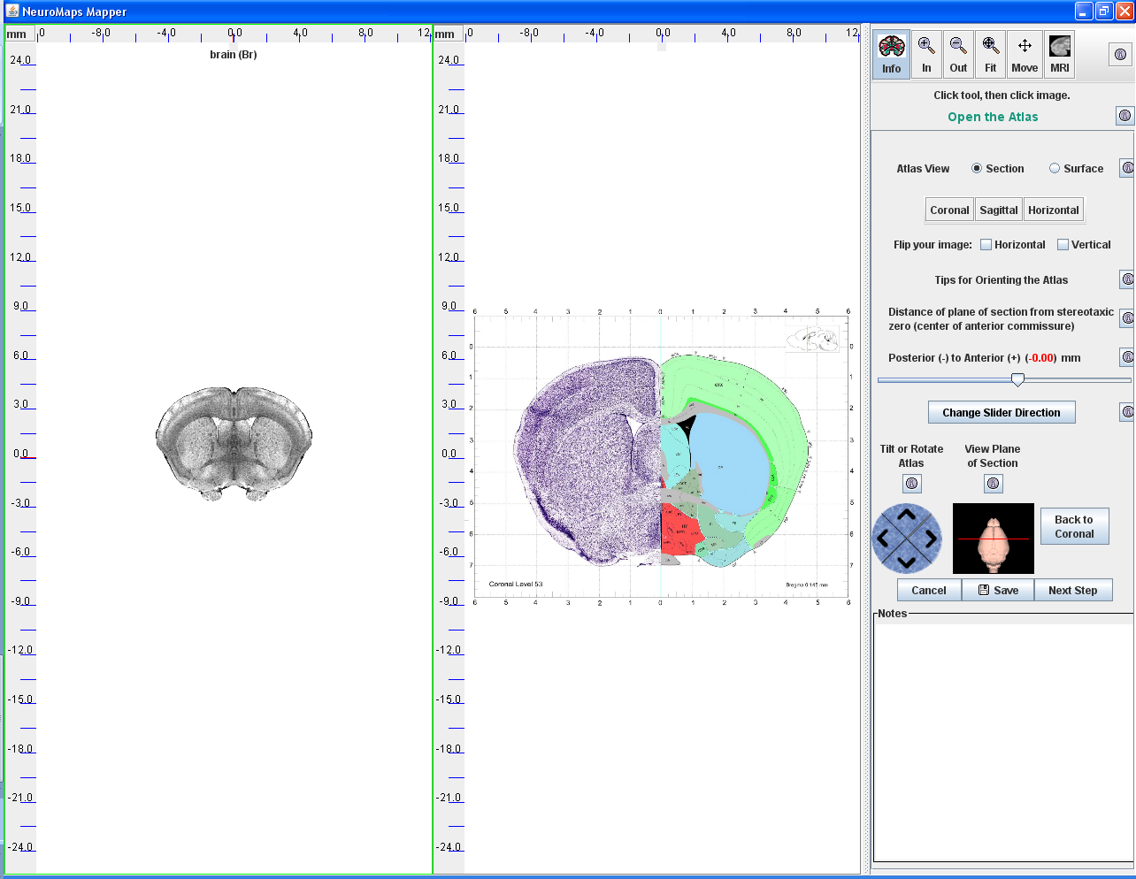
Select the view of the Atlas that best matches the Allen image:
Select View: Section or Surface;
Coronal, Sagittal or Horizontal; Use the Slider to navigate to the best level;
Tilt and Rotate for best match.
This is the Atlas

Slide 5
Rotate the Image if necessary; expand it and the Atlas to fit the panels.

Slide 6
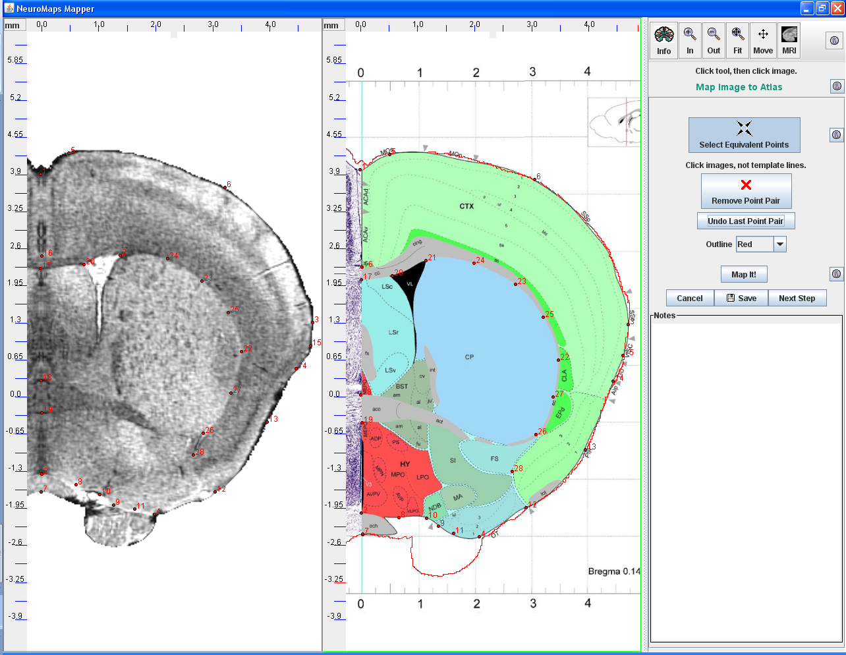
Click pairs of equivalent landmark points in the Atlas and the Image;
click ‘Map It!’ to warp the data image to the Atlas.

Slide 7
One can judge the magnitude of the nonlinear warp by the change in the grid of the image.
Click ‘New Overlay’ to begin mapping the first architectonic area into the Atlas

Slide 8
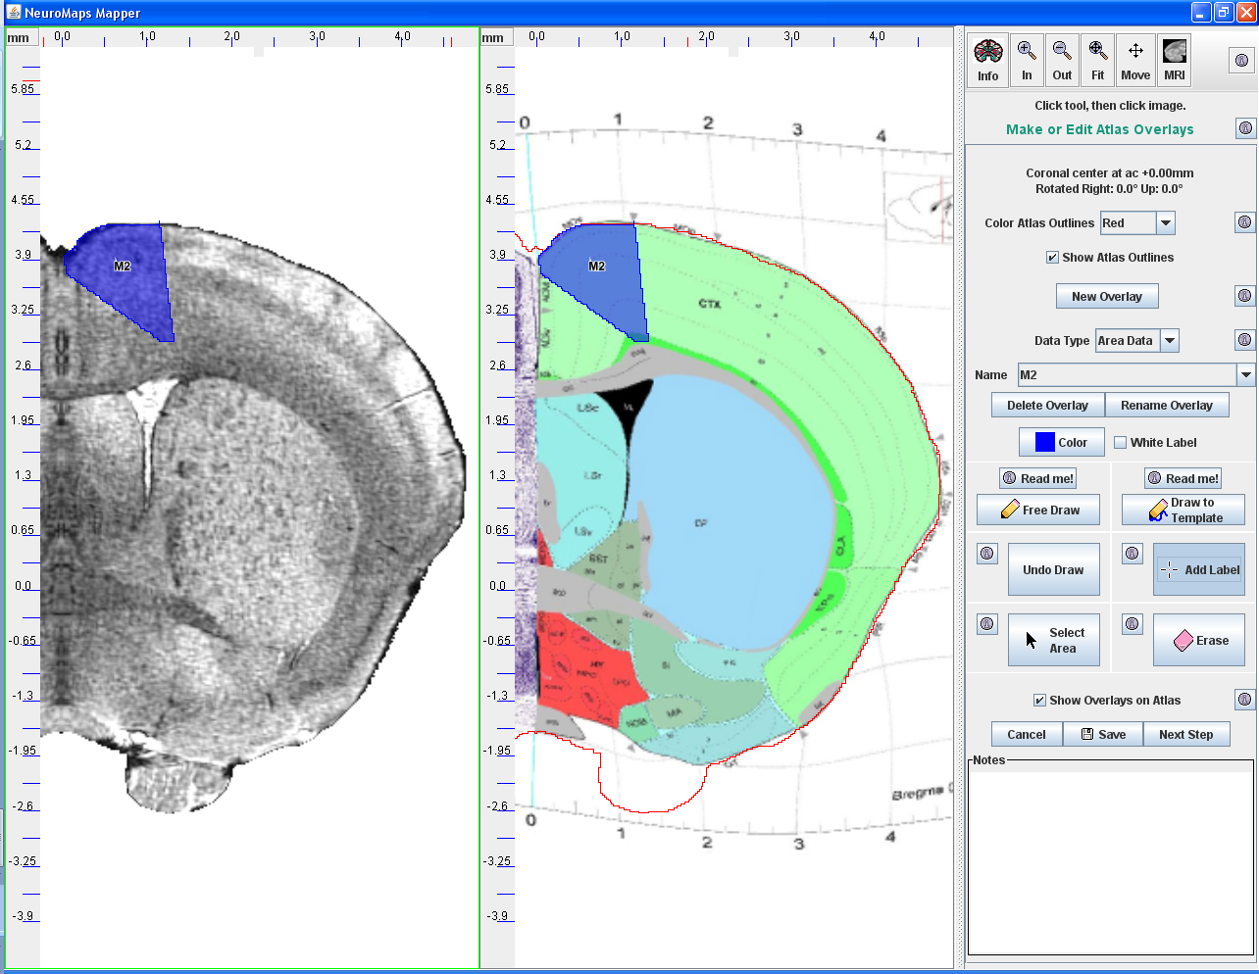
Use the ‘Free Draw’ and ‘Draw to Template’ tools to draw a boundary around area M2; use the ‘Add Label’ tool to label it.

Slide 9
Repeat the process to map and label all of the cortical areas.

Slide 10
Load the image and ‘data’ overlays into NeuroMaps’ image processor to edit for publication.

Slide 11
Adjust the colors and labels of the individual data overlays, in this case each of the architectonic areas.

Slide 12
Adjust the dpi (dots per inch) and width of the image to match your publisher’s figure specs.
Then ‘Save and Export’ to your Desktop.

Slide 13
A
B
C
Cortical areas from three mouse brain atlases mapped to the Waxholm canonical brain. Areas from Atlases A and B were mapped to the true coronal plane 0.02 mm rostral to the origin of the stereotaxic space, i.e., center of the anterior commissure (ac +0.02mm). The nearest comparable page of Atlas C was mapped to the NeuroMaps plane ac -0.17mm with the top tipped forward 6º.
Some areas, such as the superior and inferior parts of the anterior cingulate gyrus, yellow and light green respectively, are quite similar in the different atlases. Other areas, such as the primary motor area, dark blue, and secondary sensorimotor area, pink, are twice as large in atlas C as in A and B. Some regions, such as the primary sensorimotor area, red, are segmented to a much greater degree by one author (C) than by the others.
Comparisons of this kind are very difficult to carry out by any method other than mapping to a common template. NeuroMaps is designed to facilitate mapping of structures and data from multiple sources to the common Waxholm template for sharing over the Web.

Slide 14
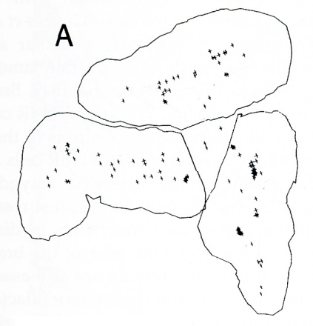
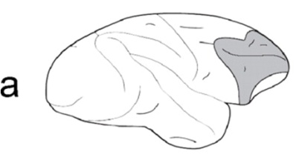
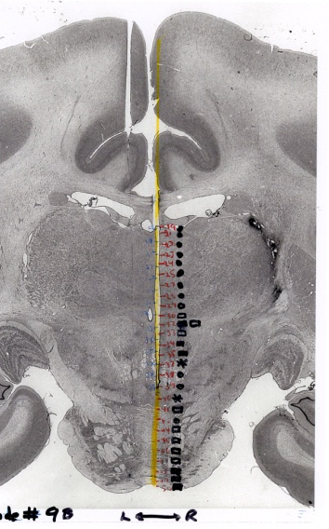
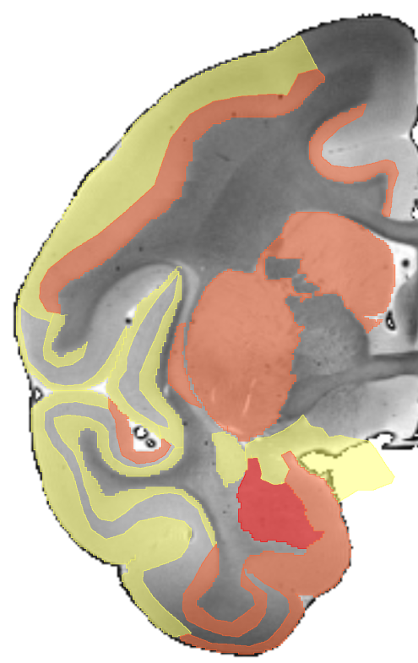
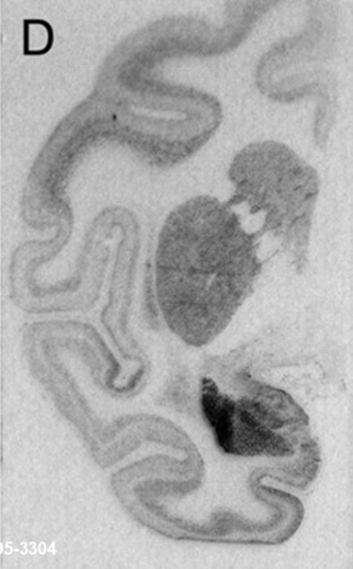
Four Modes of Data Mapped to the NeuroMaps Macaque Atlas
Dopaminergic cells in prefrontal cortex. Dubach M (1994) from Phylogeny and Development of Catecholamine Systems, Smeets JAJ and Reiner A Eds.
Lateral prefrontal cortex lesion
causing top-down attentional deficit .
Rossi, A. F. et al. J. Neurosci. 2007;27:11306-11314
Hi Positive
Med Positive
Lo Positive
Negative
No Effect
Hi expression
Med expression
Lo expression
Sites of positive and negative
reinforcement
by electrical brain stimulation
Bowden DM (unpublished)
Expression of gene GUCY1A3 in infant macaques subjected to maternal deprivation
Sabatini, M. J. et al. J. Neurosci. 2007;27:3295-3304

